Slide 1
Ol’Chat
A new way of combination

Slide 2
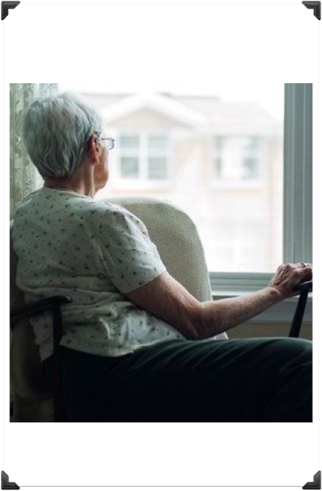
Look at how sad she looks…
Don’t you feel sad ?!

Slide 3
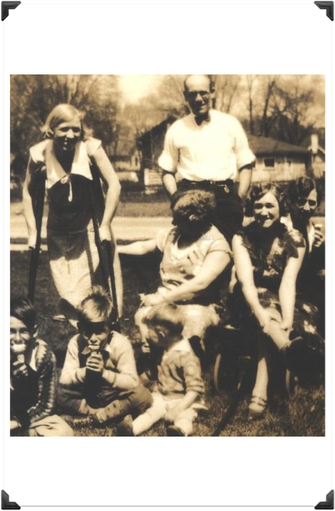
Look at how happy she was…
If only there was a way to make her happy again !

Slide 4
Now there is a way !

Slide 5
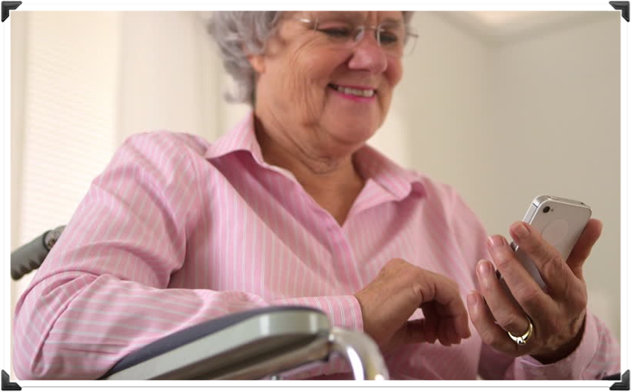
Look at how happy she is now that she is using Ol’Chat
Now she can communicate with her whole family !

Slide 6
Where can you find it ?

Slide 7

Nothing easier !

Slide 8

Now thanks to Ol’Chat they can all be happy together !

Slide 9
<3

